Slide 1
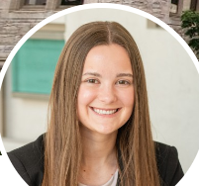
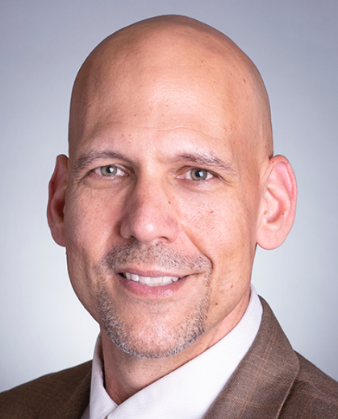
Project overview for Packowski’s Active Learning Grant Report
Executive Summary:
2023 CITL Active Learning Grant (ALG)
ALG Focus: How To Empower An Active Learning Classroom Through Strategic And Purposeful Classroom Assessment Techniques
Number of Semesters Implemented
2 (Fall 2023 / Spring 2024)
Course Implemented In
BUS-T275 Compass 2 / BUS-T276 Honors Compass 2
Strategic Recruiting Preparedness
BUS-T275/BUS-T276 is the second in a series of three professional development courses through the Kelley School of Business (BUS-T175, BUS-T275, and BUS-T375)* that provide students with career readiness skills. They will sharpen interviewing skills, customize resumes, and enhance communication using theoretical frameworks. Building on personal brand concepts, students will continue to engage in networking, give and receive feedback in teams, and enhance awareness of cultural competence. * all three courses are also offered in an Honors Version
Teaching Assistant Supported Sections /
# of Students¹
3 (out of 10 sections)
128 (out of 434 students)
Ishan Malani
Teaching Assistant
Fall 2023 / Spring 2024
Paige Osbourne
Teaching Assistant
Spring 2024
Joe Packowski
Lecturer
Fall 2023 / Spring 2024
Data Sourcing: Joe Packowski, Fall 2023 to Spring 2024 Semesters, OCQ Data, TA Data, and Personal Self-Planners. Updated through 05/15/2024
Owner: Joe Packowski l Indiana University-Bloomington. Kelley School of Business l For Internal Use Only l 05/15/2024
Page 1 of 4

Slide 2
Context and outcomes
Executive Summary:
2023 CITL Active Learning Grant (ALG)
ALG Focus: How To Empower An Active Learning Classroom Through Strategic And Purposeful Classroom Assessment Techniques
Situation: As an educator in higher education, have you ever asked yourself any of these questions when reflecting on your teaching; “Why aren’t my students participating more?”, “I have to find a way to get other students more involved.”, or “Am I lecturing to much and for too long?” What barriers or challenges do instructors face when striving for an active learning environment where students feel welcomed, embrace participation, and genuinely want to engage with others? What was I missing or, said differently, what is the research saying about motivation and student engagement in the classroom? Brophy argued that this active and purposeful student engagement must “focus on encouraging students to engage in activities with motivation to learn: That is, with the intention of acquiring the knowledge or skills that the activities are intended to develop” (Brophy, 2024, p. 4). This led me to want to learn more about both why and how students learn. The Self Determination Theory, originally shared with us over 40 years ago regarding one’s intrinsic motivation, has evolved to now embrace this as “a more general theory of human motivation, personality development, and wellness” (Ryan, Soenens, & Vansteenkiste, 2019). Armed with this information and genuine desire to want my students to learn through active and purposeful participation, I applied for and was awarded an Active Learning Grant (ALG) from Indiana University’s Center for Innovative Teaching and Learning (CITL) in 2023 – with a focus on active learning.
Brophy, J. (2004). Motivating students to learn (2nd ed.). Lawrence Erlbaum Associates Publishers.
R.M. Ryan, B. Soenens, M. Vansteenkiste. Reflections on self-determination theory as an organizing framework for personality psychology: Interfaces, integrations, issues, and unfinished business Journal of Personality, 87 (1) (2019), pp. 115-145.
ALG Vision of Success: Through the partnership of teaching assistants supporting our course design and quantified/qualified observations, our collaborative goals are to attain 100% purposeful student engagement in every class - through the diverse and strategic utilization of classroom assessment techniques (CAT’s) - and achieve a balance of 50% lecture / 50% student engagement* by the end of the Spring 2024 semester.
* Foundational / Anecdotal Benchmark: My historical classroom experience is ~ 75% lecture / 25% student engagement.
Framework: The following infrastructure was assessed, adapted, deployed and evolved over this 2 semester ALG:
Aligned my ALG Proposal to scholarly research, vision of CITL/IU, and personal teaching theory/pedagogical principles.
Met with CITL stakeholders to ensure ALG goals and vision aligned prior to implementation.
Leveraged research funding ($1,500) to line-item expenditures (hiring of TA’s, purchase supplies/hardware – iPad, activity dry-erase board tents).
Posted “TA Job Descriptions” in my courses to then interview current BUS-T275 students for this partnership opportunity in a future course.
Met with CITL and TA’s to construct the ALG vision and tactics to support the goal (assessment tools, KPI’s, anticipatory planning).
Enhanced a version of The Classroom Observation Protocol for Undergraduate STEM (COPUS: A New Instrument to Characterize University STEM Classroom Practices) for in-class quantified observations by the TA’s. Reference: https://www.lifescied.org/doi/10.1187/cbe.13-08-0154
Researched/Deployed various CAT’s (dry-erase activity tents, polling, Solstice, volunteering, group-think, start/end of class reflections, etc.).
Shared the vision and goal of this ALG with each section to welcome them on our active learning journey together.
Met with TA’s after each class and once a month to review what is working, what is not, and what is missing aligned to our vision.
Assessed effectiveness of CAT’s through quantified and qualified TA observation data – complementing a Mid-Semester survey for adaptability.
Assessed Fall 2023 data/insights and adjusted course design for the Spring 2024 semester – via shared file system online – for comparative analysis.
Outcomes: The following results were achieved aligned to TA specific sections and/or total course impact ¹:
49.2% and 50.8%. Over two semesters and 3 sections engaged by Ishan (2, F23 and SP24) and Paige (1, SP24), we achieved a ratio of 49.2% Student Listening/Instructor Lecturing and 50.8% Student Engagement/Instructor Observing. ^{1B}
+34.4%. Student self-reported level of learning growth - a comparison of total class content baselines on initial content understanding (pre-quizzes) and ability to then influence themselves or others (post-quizzes). This +34.4% growth is 9.5 percentage points higher (or +38%) in the active learning classrooms associated with this ALG compared to previous courses where CAT’s were not leveraged strategically or purposefully. ^{1A}
87.6%. Through an added OCQ (online course questionnaire) question, 54.8% of enrolled students participated in this end of the semester OCQ. 87.6% of students Strongly Agreed (56.7%) or Agreed (30.9%) that “our course provided you with opportunities to participate, engage, and feel welcomed/valued at a level you felt comfortable through the various activities and engagement exercises (activity tents, polls, volunteering, randomizer).” 6.5% of students Disagreed (5.5%) or Strongly Disagreed (0.9%). ^{1A}
+13.1% and +10.3%. For an evidence of learning (EoL) analysis as part of my promotion dossier aligned to a Final Individual Cover Letter assignment, by incorporating strategic and purposeful CAT’s and lecture/student engagement enhancements, comparing the Spring 2023 to Fall 2023/Spring 2024 ALG semesters (through a 25% student randomizer sample): observed a +13.1% student percentage point increase in students earning Satisfactory Work (≥ 80% of the rubric criteria) on their initial submission and a +15.9% student percentage point increase in students resubmitting work to earn Satisfactory Work. ^{1A} Please note that I leverage Driver’s Seat Grading in all courses (adapted from Specifications Grading – a pass/fail system by assignment with the flexibility to use TOKENS to resubmit work and apply learnings/feedback.
Learnings: Reflections from TA’s and myself regarding this ALG and sustainable implementation:
Ishan and Paige: Variations occurred between class times (9:45am and 11:30am) and consistency in observing 100% of classes. High observational classes included those leveraging activity tent/dry erase boards in a table/group setting. Opportunities exist to engage TA’s more during class activities and possibility to host own student consultation office hours. Appreciated opportunity to share perspectives, though, during class time.
Joe: Important to offer TA position sustainably. Opportunity to quantify specific CAT’s and their impact on assignments/learnings. Continuous focus on Driver’s Seat Grading (learning over grades), frequent course map design assessment, sharing of best practices, and risk mitigation practices.
Data Sourcing: Joe Packowski, Fall 2023 to Spring 2024 Semesters, OCQ Data, TA Data, and Personal Self-Planners. Updated through 05/15/2024
¹ Data Details: Designated within this ALG as either: ^{1A} all sections or ^{1B} TA supported sections only as noted. Updated through 05/15/2024
Owner: Joe Packowski l Indiana University-Bloomington. Kelley School of Business l For Internal Use Only l 05/15/2024
Page 2 of 4

Slide 3
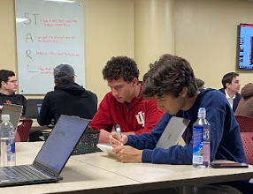
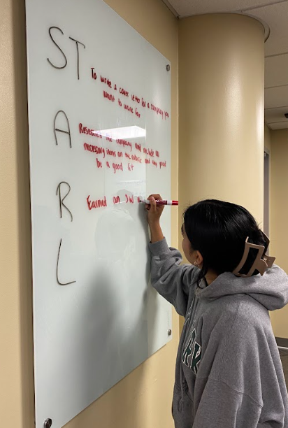
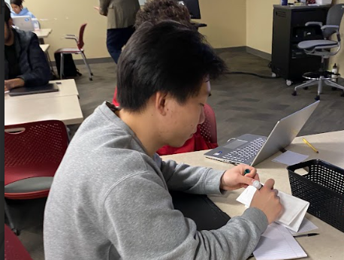
Student feedback on the project
Executive Summary:
2023 CITL Active Learning Grant (ALG)
Student Balanced Feedback on our ALG Classroom:
(via an added OCQ Qualified Question)…
“From an active learning perspective, please comment on whether or not our
course provided you with opportunities to participate, engage, and feel
welcomed/valued at a level you felt comfortable through the various activities and engagement exercises (activity tents, polls, volunteering, randomizer).”
Yes, Professor Packowski was always deploying new strategies for engagement and feedback collection. He seemed to truly value what each student had to say during opportunities to share.
I was presented with many opportunities to engage. The professor made sure each student felt comfortable but was also doing their best in each weekly activity.
I felt comfortable volunteering every week.
I felt my voice and participation was heard in many different ways which was beneficial.
I liked the polls and volunteering aspect of the course. It felt welcoming for all learners.
I felt like I had many opportunities to get involved in class, and these helped me apply the concepts that we were discussing in class.
Learning was fun in this class!
I tried to participate every class and always felt encouraged to share.
We had lots of opportunities to participate! I liked how the table settings allowed me to participate when I didn't want to share with the whole class.
I noticed we needed them less and less as the semester went on because more people volunteered and openly participated.
It did! I value this class so much and can't wait to apply it in the real world.
Not really, we could just raise our hands and answer.
They were very beneficial to our learning. I feel that this helped everyone participate, as opposed to selecting a few students per question. I enjoyed getting to see everyone's answers & names, and feel this is a great way to include individuals who do not feel as comfortable raising their hand.
Yes, the course was very interactive which made learning better.
Name (activity) tents were cool!
Super engaging!
I thought the name tents was innovative and increased participation.
This was beneficial because everyone was engaged.
Data Sourcing: Joe Packowski, Fall 2023 to Spring 2024 Semesters, OCQ Data, TA Data, and Personal Self-Planners. Updated through 05/15/2024
Owner: Joe Packowski l Indiana University-Bloomington. Kelley School of Business l For Internal Use Only l 05/15/2024
Page 3 of 4

Slide 4
Quotes to Leverage:
Executive Summary:
2023 CITL Active Learning Grant (ALG)
I truly believe students want to learn and apply their experiences beyond the classroom. It is our calling to then help foster a welcoming, active, and purposeful learning environment where students can thrive and engage at various comfort levels throughout the semester. This ALG provided a positive experience to help in achieving this vision sustainably.
The ability to partner with TA’s, who were former students of mine, was a game-changer. Having their input, perspectives, and connectivity to the pulse of the class provided incredible insights to strive for an active learning classroom.
Joe Packowski
Overall, I also wanted to note that as a TA, I know that I have gotten just as much out of this experience as I’ve provided to the class or to Prof Pack, a unique element of holding a TA position for Compass.
Joe Packowski
Paige Osbourne
Data Sourcing: Joe Packowski, Fall 2023 to Spring 2024 Semesters, OCQ Data, TA Data, and Personal Self-Planners. Updated through 05/15/2024
Owner: Joe Packowski l Indiana University-Bloomington. Kelley School of Business l For Internal Use Only l 05/15/2024
Page 4 of 4

